Slide 1
Fluidic Control of Compressor Surge
B. Tech. Project
Student: S Sajin (Y7373)
Guide: Dr. Abhijit Kushari

Slide 2
Abstract
Surge and rotating stall are mature forms of the natural oscillatory modes
Initial disturbance with very small amplitude and high frequency grows into a large amplitude form with low frequency
This project aims at
Identifying precursors to surge
Controlling surge by using an active fluidic feedback control

Slide 3
Experimental Setup
10 HP Crompton Greaves Motor (max. frequency 50 Hz) connected to a two stage axial compressor
Variable speed drive for regulating rpm (Altivar 312, Schneider Electric)
Electronic speed controls for the DC motor
Three-phase supply voltage: 380…500 V 50/60 Hz
Integrated Electromagnetic Compatibility filter
A venturi-tube for measuring mass flow rate
A butterfly valve for regulating mass flow rate
Pressure and Torque Sensors
SCIENTIFIC Multiple power supply PSD3304 (30 V max)
Data Acquisition Card – National Instruments USB-6210
Weights for torque calibration

Slide 4
Sensors
KISTLER Basic Line Torque Sensor
Tension ring – Strain Gages – Rotor Electronics – Stator Electronics
Power Supply 18-26 V DC
Range 0 to 10 V; Torque: 0 to 50 Nm
AUTO TRAN Pressure Sensor; Model 851-48-P-18-S-P
Piezoresistive Strain Gage
Power Supply 18-24 V DC
Range 1 to 5 V; Pressure: 0 to 4 psi
Kulite Ultra Miniature Pressure Transducer, XCS-062 series
Miniature IS Silicon Diaphragm Pressure Transducer – Capacitive
Supply Voltage 10 V DC
Range 0 to 50 mV; Pressure 0 to 5 psi gage
ASCX Differential Pressure Sensor
Strain gage type pressure sensor
Supply Voltage 5 V DC
Range 0.25 to 4.75 V; Pressure 0 to 1 psi
SM5812 Differential Pressure Sensor
MEMS based pressure sensor
Supply Voltage 12 V DC
Range 0.5 to 4.5 V; Pressure -0.3 to +0.3 psi

Slide 5
Torque Calibration

Slide 6
Measurement Ports
Port 1 – Compressor Inlet
Port 2 – 1st Stage Exit
Port 3 – 2nd Stage Inlet
Port 4 – Compressor Exit
Port 5 – Venturi Inlet
Port 6 – Venturi Throat
Initially the pressures at each port were measured using AUTO TRAN to obtain the ranges of pressure at each port

Slide 7
Pressure Measurements

Slide 8
New Setup
Kulite Pressure Sensors at Ports 1 and 4
Measurement of Gage Pressures at 1 and 4
SM5812 Differential Pressure Sensor
Pressure rise across compressor
ASCX Differential Pressure Sensor across 5 and 6
Pressure drop across the venturi to determine mass flow rate

Slide 9
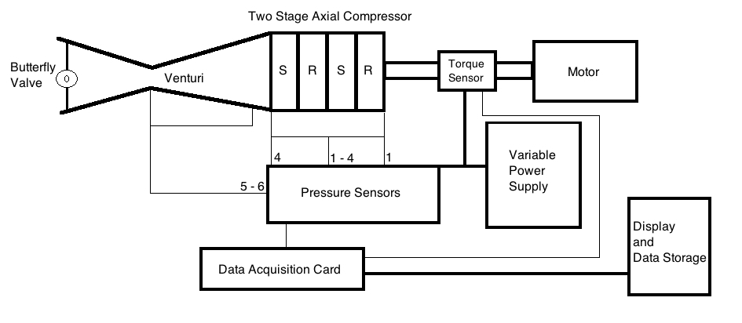
Schematic of Experimental Setup

Slide 10
Compressor Characteristics

Slide 11
∆V_{θ}/U v/s V_{z}/U

Slide 12
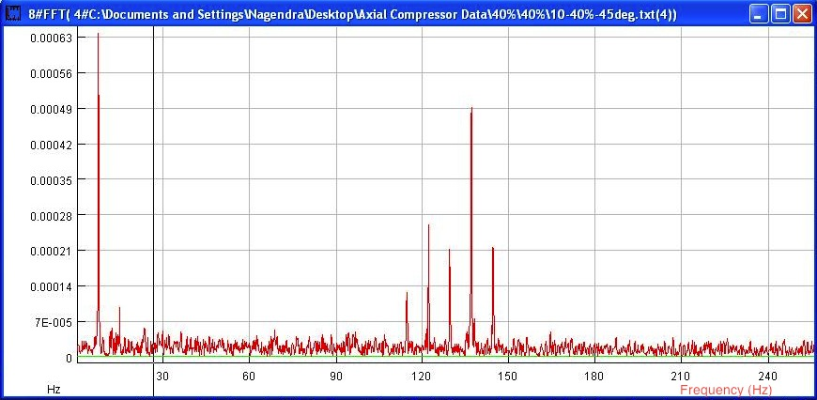
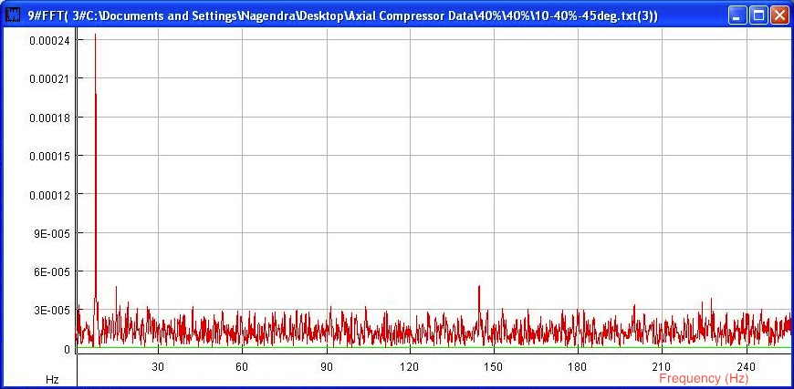
FFT of data from ports 1 and 4
Port 1
Port 4

Slide 13
Inferences
Compressor characteristics obtained
Narrow downward sloping region
∆V_{θ}/U v/s V_{z}/U curve somewhat matches theoretical predictions
Theoretically
∆V_{θ}/U = 1 – Vz/U * (tan α₁+ tan β₂)
Design and off-design flow
FFT confirms negligible errors due to
Systematic DC component
Noise due to supply line

Slide 14
Conclusions
Compressor characteristics obtained
Next step – induce surge and control it

Slide 15
THANK YOU Q/A

